Slide 1

Beyond AI Pilots
Building the control plane for an agentic enterprise
Ahmad Al Shami
Consultant | Board Advisor
Strategy • Architecture
Execution • Measured value
ahmad.alshami.website
1 / 9
Notes:
When AI agents can act across your business, who controls their decisions, and who owns the outcome? This presentation explains a proposed enterprise agent control plane. It connects business strategy to decision ownership, trusted data, controlled execution and measured results. The architecture and example are illustrative. The aim is to help leaders decide where autonomy is useful, and what must be in place before it grows.
Author synthesis and proposed architecture. Examples are illustrative, not reported client results. Visuals are generated conceptual illustrations. Video uses synthesized English narration.
Full article: https://ahmad.alshami.website/blog/transformation-ai-insights-7/beyond-ai-pilots-building-the-control-plane-for-an-agentic-enterprise-24

Slide 2
Why governance matters now
October 2026
Industry direction
Microsoft: agent oversight
and UAE availability
Ownership
Access and policy
Evidence and value
McKinsey: redesign work
around business outcomes
Announcement ≠ organizational readiness
ahmad.alshami.website
2 / 9
Notes:
Recent industry announcements make this a timely discussion. Microsoft announced Agent 365 availability in United Arab Emirates data centres starting October, emphasizing observability, governance and security. McKinsey's October fifth article argues for redesigning work around outcomes and mapping how people and agents cooperate. These sources signal a direction, not a guarantee of readiness. My recommendation is to make ownership and operating rules part of the systems doing the work.
Microsoft announcement: https://news.microsoft.com/source/emea/2026/09/agent-365-availability-in-the-uae/
McKinsey, October 5 2026: https://www.mckinsey.com/capabilities/people-and-organization/our-insights/ai-is-changing-work-now-it-has-to-change-the-organization
Author synthesis and proposed architecture. Examples are illustrative, not reported client results. Visuals are generated conceptual illustrations. Video uses synthesized English narration.
Full article: https://ahmad.alshami.website/blog/transformation-ai-insights-7/beyond-ai-pilots-building-the-control-plane-for-an-agentic-enterprise-24

Slide 3
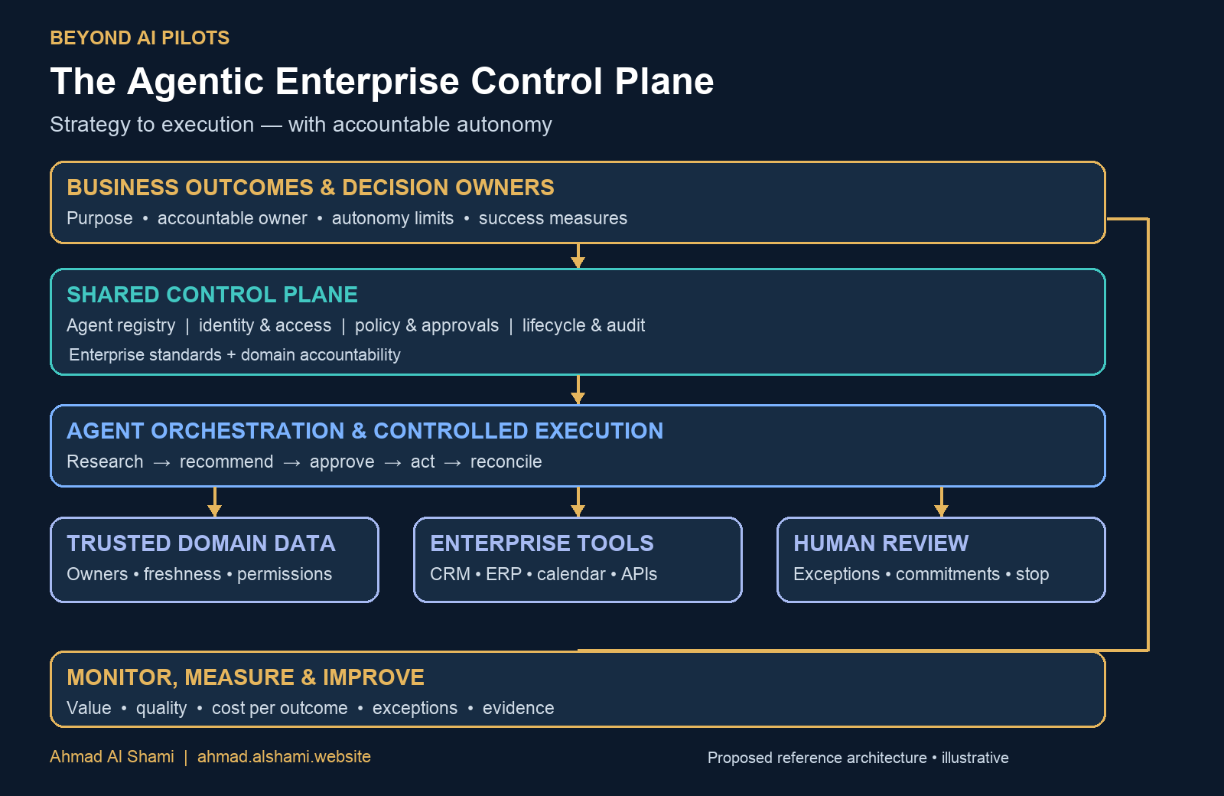
The agent control plane
Control plane
Defines ownership,
access and policy
Execution layer
Carries out
approved work
ahmad.alshami.website
3 / 9
Notes:
A control plane defines which agents exist, who owns them, what they can access, which actions need approval and how performance is assessed. The execution layer then carries out approved work. The diagram connects business outcomes to shared controls, agent orchestration, trusted data, enterprise tools and human review. Monitoring feeds improvement back into the operating model. This distinction helps an organization change its technology without losing its business controls.
Author synthesis and proposed architecture. Examples are illustrative, not reported client results. Visuals are generated conceptual illustrations. Video uses synthesized English narration.
Full article: https://ahmad.alshami.website/blog/transformation-ai-insights-7/beyond-ai-pilots-building-the-control-plane-for-an-agentic-enterprise-24

Slide 4
Decision ownership
Decision level | Illustrative action | Authority
Automatic | Classify an enquiry | Within agreed limits
Recommendation | Suggest a service | Review if required
Commitment | Approve a discount | Authorized person
For every agent: owner, custodian, autonomy limits, escalation
ahmad.alshami.website
4 / 9
Notes:
Start with a bounded business outcome and a named accountable owner. Distinguish three levels: work an agent can perform automatically, recommendations it can prepare, and commitments reserved for an authorized person. For example, classifying an enquiry may be automatic. Recommending a service may require review. Approving a discount or contractual promise requires the appropriate authority. Record the business owner, technical custodian, autonomy limits and escalation route for every agent.
Author synthesis and proposed architecture. Examples are illustrative, not reported client results. Visuals are generated conceptual illustrations. Video uses synthesized English narration.
Full article: https://ahmad.alshami.website/blog/transformation-ai-insights-7/beyond-ai-pilots-building-the-control-plane-for-an-agentic-enterprise-24

Slide 5

Trusted data and access boundaries
Domain data owners
Meaning and freshness
Agent identity
Scoped tools and access
Tenant boundaries
Enforced in every layer
ahmad.alshami.website
5 / 9
Notes:
Map the workflow to its capabilities, information and applications. Give each agent a traceable identity and only the access needed for its role. Domain-owned data products can provide clear meaning, ownership and freshness expectations. A data mesh approach also needs shared governance and a usable platform. In a multi-tenant service, enforce tenant boundaries in retrieval, credentials, execution, storage and publishing. A tenant name inside a prompt is not an access control.
Data mesh background, Dehghani, May 20 2019: https://martinfowler.com/articles/data-monolith-to-mesh.html
Author synthesis and proposed architecture. Examples are illustrative, not reported client results. Visuals are generated conceptual illustrations. Video uses synthesized English narration.
Full article: https://ahmad.alshami.website/blog/transformation-ai-insights-7/beyond-ai-pilots-building-the-control-plane-for-an-agentic-enterprise-24

Slide 6

Controlled execution and recovery
Authorize before action
Record the evidence
Prevent duplicate effects
Reconcile uncertain results
Provide a manual route
ahmad.alshami.website
6 / 9
Notes:
Separate research, recommendation, approval and execution. Check permissions when a tool is called, and retain evidence of the inputs, approval and outcome. Use a durable duplicate-prevention key for each external action. If a request times out, reconcile the destination before retrying. An uncertain response does not prove the action failed. Provide a stop mechanism and a manual route when data is missing, policies fail or the result cannot be verified.
Author synthesis and proposed architecture. Examples are illustrative, not reported client results. Visuals are generated conceptual illustrations. Video uses synthesized English narration.
Full article: https://ahmad.alshami.website/blog/transformation-ai-insights-7/beyond-ai-pilots-building-the-control-plane-for-an-agentic-enterprise-24

Slide 7
Example: enquiry to appointment
Illustrative consulting workflow
01
→
02
→
03
→
04
→
05
Enquiry
Catalogue
CRM check
Calendar
Appointment
Identify need
Permitted services
Avoid duplicates
Approved availability
Confirm valid slot
Unclear request → consultant review
ahmad.alshami.website
7 / 9
Notes:
Consider an illustrative consulting enquiry. The agent reads the permitted service catalogue and suggests an appointment type. It checks for an existing enquiry before creating a customer relationship management record. It reads approved calendar availability before proposing a slot. It can prepare an acknowledgement, while unclear requests go to the consultant. It cannot invent prices, promise unavailable dates or access another tenant's customer data. Measure valid appointments and errors, not just messages generated.
Author synthesis and proposed architecture. Examples are illustrative, not reported client results. Visuals are generated conceptual illustrations. Video uses synthesized English narration.
Full article: https://ahmad.alshami.website/blog/transformation-ai-insights-7/beyond-ai-pilots-building-the-control-plane-for-an-agentic-enterprise-24

Slide 8
Measure the whole business outcome
Business result | Operational quality | Control evidence
Cycle time | Accepted output | Approval records
Cost per outcome | Exception rate | Unauthorized attempts
Realized benefit | Review effort | Duplicate actions
Baseline first; increase autonomy only when thresholds are met
ahmad.alshami.website
8 / 9
Notes:
Establish a baseline before deployment. Track cycle time, accepted output quality, exception rate, cost per completed outcome and realized business benefit. Monitor unauthorized-action attempts, duplicate actions and human review effort alongside productivity. A faster workflow can still create more rework downstream. Increase autonomy only when evidence shows that agreed quality, risk and cost thresholds are met. Keep the domain owner accountable for the business result.
Author synthesis and proposed architecture. Examples are illustrative, not reported client results. Visuals are generated conceptual illustrations. Video uses synthesized English narration.
Full article: https://ahmad.alshami.website/blog/transformation-ai-insights-7/beyond-ai-pilots-building-the-control-plane-for-an-agentic-enterprise-24

Slide 9
Your first controlled workflow
1 Select one outcome
2 Map decisions and systems
3 Configure scoped controls
4 Test failure and recovery
5 Review before expanding
Read the article and download the slides
ahmad.alshami.website
9 / 9
Notes:
A first implementation can be simple. Select one workflow with a clear owner and baseline. Map its decisions, data, systems and approval limits. Configure scoped tools and identity controls. Test missing data, duplicate requests, timeouts and policy failures. Review actual results before expanding permissions. Enterprise standards should support domain accountability without duplicating every decision. Read the full article and download the presentation at Ahmad dot Alshami dot website. Strategy to execution, with accountable autonomy.
Author synthesis and proposed architecture. Examples are illustrative, not reported client results. Visuals are generated conceptual illustrations. Video uses synthesized English narration.
Full article: https://ahmad.alshami.website/blog/transformation-ai-insights-7/beyond-ai-pilots-building-the-control-plane-for-an-agentic-enterprise-24

